Slide 1
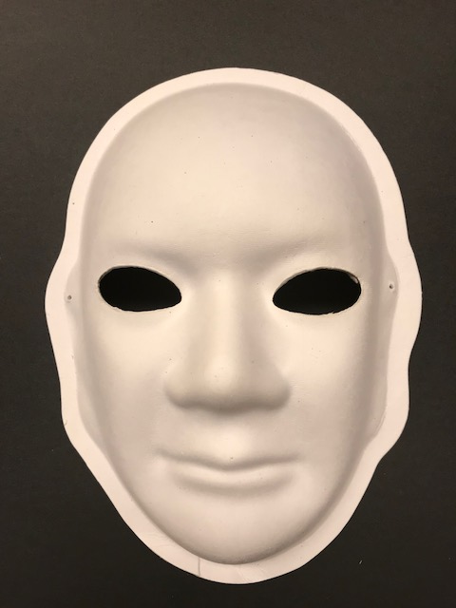
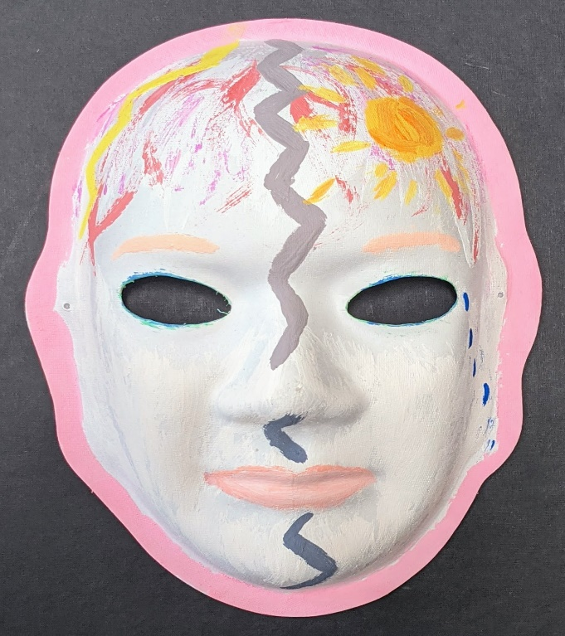
Developing and Adapting an Art Therapy Mask Creation Intervention for Individuals with Traumatic Brain Injury Across Clinical and Non-clinical Settings
Stephen Heck, M.Res, M.A¹, Lesley Cottrell, PhD², Danielle Davidov³, Christa Lilly⁴, Sara Landes⁵ (1) West Virginia University, Center for Excellence in Disabilities, Health, Morgantown, WV, (2) West Virginia University, Department of Pediatrics and Center for Excellence in Disabilities, Morgantown, WV,
(3) West Virginia University, Social and Behavioral Sciences, Morgantown, WV,(4) West Virginia University, Epidemiology and Biostatistics, Morgantown, WV,
(5) University of Arkansas for Medical Sciences, Department of Psychiatry and
South Central Mental Illness Research Education and Clinical Center Behavioral Health QUERI, Little Rock, AK
Background
Methods
Thematic Analysis
Traumatic brain injury (TBI) is a growing public health concern that costs the United States approximately 76.5 billion dollars a year in direct and indirect medical costs.
There is a need for complementary evidence-based approaches to improve people's health and quality of life with TBI.
Art therapy mask creation (ATMC) is such an intervention. Creating a mask provides benefits, including
1) a way to see oneself as an individual, in a relationship, and within the community and larger society; and
2) a means of re-establishing self-identity through connection and representation of the masks to their own identities.
There was four phases to the study:
Phase 1 Pre-Interviews – literature review, interview guide development.
Phase 2 Interviews – initial interviews to evaluate ATMC and how to implement.
Phase 3 Toolkit Development – based on analysis of feedback from the interviews, toolkit is drafted.
Phase 4 Evaluation & Feedback – through interviews, workgroups, and focus groups to evaluate and refine toolkit.
Two semi-structured interview guides were developed to fill in gaps in our knowledge of how to implement the ATMC in a variety of settings.
First guide focused on reviewing the ATMC activity and how to implement.
Second guide focused on feedback on the ATMC toolkit, implementation strategies, and usage.
All interviews were transcribed using Otter.ai (Otter.ai, 2020) and reviewed by the author for accuracy.
Thematic analysis was conducted using NVivo 12 Plus software (QSR International Pty Ltd., 2020). Initial coding was completed by the researcher, followed by a second coder review and then a discussion of codes and review of discrepancies.
Table 1. Major themes, description and references identified from the Phase 2 interviews.
Theme | Description | References
Accommodations | Challenges and strategies to help people with TBI complete the activity | 43
Art Therapy Masks | Thoughts on the activity based on complexity, perceived participant perspective, and general perception | 93
Setting | References to using the activity in clinical (medical or rehabilitation clinic) or non-clinical (support group, at home, or social work program) settings | 155
Educational Materials | Materials needed to aid in completing the activity for individuals with TBI, caregivers, and implementers | 116
Logistics | Implementation considerations based on the need for collaboration, materials, personnel, process, recruitment, setting, time, and funding | 152
Personal Experience | Interviewees experience in working for people with traumatic brain injuries. How long they have worked in the field and what their role is. | 31
Impact of COVID-19 | COVID impact on their ability to work with people with TBIs and implementing the ATMC with COVID restrictions. | 29
*
*
Objectives
To develop and adapt the ATMC intervention for implementation in select clinical and non-clinical settings for individuals with a TBI.
Implementation strategies and activities
Art Therapy Mask Creation
Strategy | Activity
Assess for readiness and identify barriers and facilitators | Assess various aspects of an organization to determine its degree of willingness to implement, barriers that may impede implementation, and strengths that can be used in the implementation effort
 | Interview professionals in the field of TBI care to determine how to implement ATMC intervention in their settings
 | Determine feasibility at local sites.
 | Identify what barriers and facilitators exist for implementing in normal care and a restrictive social distancing environment
 | Assess leadership support and resources available, clinician attitudes and beliefs, organizational climate and culture, and structure
Use advisory boards, focus groups, and workgroups | Create and engage a formal group of multiple kinds of stakeholders to provide input and advice on implementation efforts and to elicit recommendations for improvements
 | Establish intervention buy-in
 | Outline clear objectives for how to implement
 | Advise on recruitment, retention, and procedures for implementing the ATMC blueprint
Develop a formal implementation blueprint / toolkit | Develop a formal implementation blueprint / toolkit that includes goals, strategies, resources, and setting specific information
Example of ATMC. On the left is a blank papier-mâché mask supplied to an individual with a TBI. The individual is able to paint and decorate their mask to reflect their thoughts about their injury.
Table 2. Major themes, description and references identified from the Phase 4 evaluation and feedback.
Name | Description | References
Barriers and facilitators to participation | Challenges and solutions for participating in activities | 29
COVID-19 | How COVID has impacted their ability to work with people with TBIs and implementing the ATMC with COVID restrictions | 19
Implementation | Comments related to the application and use of the ATMC | 116
Toolkit Components | Comments regarding specific sections of the toolkit | 98
Value of the activity | How the activity is viewed to benefit people with TBIs and practitioners' willingness to use | 25
“Living with the long-lasting, unfolding effects of a traumatic brain injury can sometimes make you feel as though you are two people, as depicted by the gloomy, gray colored zigzag pattern down the middle of the mask. While the pink and purple represent my happy, cheerful, and hopeful personality, the red circuits and lightning bolt represent the new angry storms that can rage simultaneously with the injustices in the world. The blue, grieving tears hide from the front view of the mask in an attempt at hiding from the world because the energetic, radiant sun must continue giving the world an energy of hope. After having a TBI, all of these feelings can become overwhelmingly heightened and make you struggle with this new identity. Even when you learn to love yourself for the various parts of what makes you who you are, the hope is always that others can understand and accept all that you are.”
**
Conclusions
Toolkit is completed. It provides the necessary steps a facilitator would need to prepare, implement, and evaluate the ATMC in both clinical and non-clinical settings.
Toolkit includes:
Educational materials and recommendations for implementation in a variety of settings.
Instructional materials to provide to people with TBIs, caregivers, and professionals with guidelines to complete the activity.
A review of logistical challenges with potential solutions.
Identification of potential environmental and specialized tools
References
Otter.ai. (2020). No Title. https://otter.ai/login
QSR International Pty Ltd. (2020). NVivo (Version 12 Plus).

